Slide 1
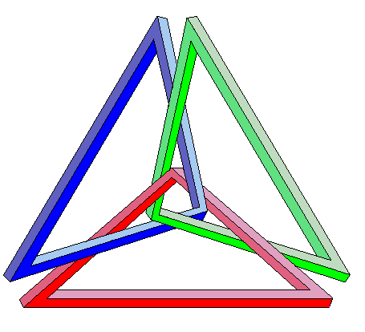
National Platform for Knowledge Triangle in Serbia
National Platform for Knowledge Triangle in Serbia –KNOWTS
158881-TEMPUS-RS-JPHES
In hoc signo vinces
Synergy between education, research and innovation

Slide 2
Goals:
National Platform for Knowledge Triangle in Serbia
KNOWTS 158881-TEMPUS-RS-JPHES
to discuss issues of the knowledge triangle
to set strategic objectives related to the sustainable development
to demonstrate development opportunities that rely on education, research and innovation
to offer recommendations for synergy between policies in education, research and innovation to academic community, business and government authorities in the Republic of Serbia

Slide 3
Authors:
National Platform for Knowledge Triangle in Serbia
KNOWTS 158881-TEMPUS-RS-JPHES
Prof. Ivan Milentijević, University of Niš
Prof. Milorad Tošić, University of Niš
Prof. Vera Dondur, National Council for Research and Technology Development
Prof. Ivanka Popović, University of Belgrade
Gordana Grković Danilović, University of Belgrade
Prof. Veljko Malbaša, University of Novi Sad
Prof. Vojin Šenk, University of Novi Sad
Prof. Ladislav Novak, University of Novi Sad

Slide 4
Authors:
National Platform for Knowledge Triangle in Serbia
KNOWTS 158881-TEMPUS-RS-JPHES
Prof. Dušica Pavlović, University of Niš
Prof. Dragan Milosavljević, University of Kragujevac
Prof. Vesna Mandić, University of Kragujevac
Marina Vukobratović Karan, Ministry of Education, Science and Technology Development
Sanja Pavlović, Ministry of Education, Science and Technology Development
Tijana Knežević, Ministry of Education, Science and Technology Development

Slide 5
Reviewers:
National Platform for Knowledge Triangle in Serbia
KNOWTS 158881-TEMPUS-RS-JPHES
Prof. Srdjan Stanković, National Council for Higher Education, Serbia
Prof. Claudio Moraga, European Centre for Soft Computing, Spain
Dr. Norbert Jesse, QuinScape, Dortmund, Germany
Prof. Peter Kopacek, Vienna University of Technology, Austria
Dr. Timothy Dee, Canterbury Christ Church University, UK
Prof. Leonel Sousa, Instituto Superior Techico, Lisbon, Portugal
Prof. Marijan Gušev, Regional Expert, Macedonia
Prof. Katerina Georgouli, TEI-Athens, Greece
Prof. Željko Djurović, University of Belgrade, Serbia
Prof. Viktor Nedović, University of Belgrade, Serbia

Slide 6
Methodology:
National Platform for Knowledge Triangle in Serbia
KNOWTS 158881-TEMPUS-RS-JPHES
Forming of the National Inter-Institutional Advisory Board – NIIAB
Authors + reviewers = NIIAB members
Acquiring of experiences (workshops and visits to EU Universities)
Collecting and selection of relevant EU documents
Analysis of current state in the Republic of Serbia
Creation of the structure of the Platform
Task assignment and sections development
Review procedure at section level
Integration and external review

Slide 7
Contents:
National Platform for Knowledge Triangle in Serbia
KNOWTS 158881-TEMPUS-RS-JPHES
Executive summary
Republic of Serbia – current state
2.1. Internal structure
2.2. External factors
Strategic goals
Recommendations
Best practice examples

Slide 8
2.1. Internal structure
National Platform for Knowledge Triangle in Serbia
KNOWTS 158881-TEMPUS-RS-JPHES
Serbia – general remarks and global competitiveness index
Population structure
Development Policy – Legislative Framework and Documents
Education
Research
Innovation system
New infrastructure investments
Business environment

Slide 9
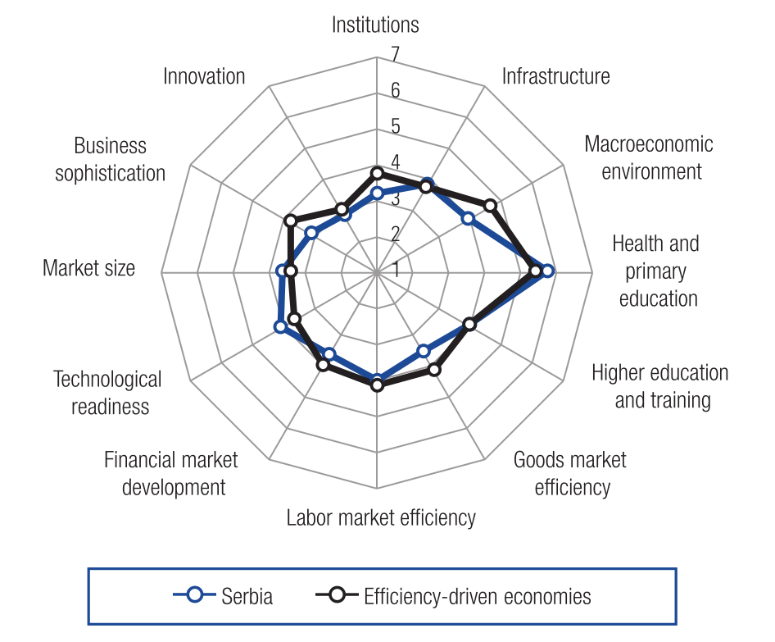
2.1.1. General remarks and GCI
National Platform for Knowledge Triangle in Serbia
KNOWTS 158881-TEMPUS-RS-JPHES
State of development according to GCI pillars
Serbia is at the 95th place out of 144 analyzed states

Slide 10
2.1.2. Population structure
National Platform for Knowledge Triangle in Serbia
KNOWTS 158881-TEMPUS-RS-JPHES
We give population structure by:
large age group and sex
functional age population contingents
number of employed
education structure of unemployed persons
average time spent in different activities for the population older than 15
average salaries in various sectors
Main source: Statistical Office of the Republic of Serbia YearBook 2010/11

Slide 11
2.1.3. Development Policy – Legislative Framework and Documents
National Platform for Knowledge Triangle in Serbia
KNOWTS 158881-TEMPUS-RS-JPHES
list of applicable documents and laws governing technological development, scientific research and innovation activities:
Research and Innovation policy related documents
Intellectual property related laws
Titles and election procedures for researchers

Slide 12
2.1.4. Education
National Platform for Knowledge Triangle in Serbia
KNOWTS 158881-TEMPUS-RS-JPHES
Degree structure
Institutional structure
Higher Education Institutions
Links between the relevant parties in the QA system
Accreditation in Higher Education
Accreditation data for HEIs and study programmes
Source: CAQA Self-evaluation report
Real number of students according to:
the type of studies, financing, field od education
Analysis of teaching staff numbers
Source : Statistical yearbook, Statistical Office of the Republic of Serbia

Slide 13
2.1.5. Research
National Platform for Knowledge Triangle in Serbia
KNOWTS 158881-TEMPUS-RS-JPHES
R&D: SITUATION ANALYSIS
The number of research institutions
Number of full time researchers
Number of projects
Distribution of researchers
Total number of PhD programs at state universities
Number of PhD students
The number of articles in various research disciplines
Publication index ration
International cooperation
FP7
COST
Eureka
bilateral cooperation
NATO Science for Peace and Security
Cooperation programme with the International Atomic Energy Agency (IAEA)
UNESCO
Funding of research
Mobility of researchers in Serbia - State of play

Slide 14
2.1.6. Innovation system
National Platform for Knowledge Triangle in Serbia
KNOWTS 158881-TEMPUS-RS-JPHES
Current state of the innovation system
Companies in Serbia by innovation activity
Companies by type of innovation and sectors
Structure of the innovation system
Key instruments of innovation
Serbian innovative activities
Intellectual property
Patent activity of research institutions
Current initiatives and projects in the innovation system
Financial mechanisms (with overview of innovation project)

Slide 15
2.1.7. New infrastructure investments
National Platform for Knowledge Triangle in Serbia
KNOWTS 158881-TEMPUS-RS-JPHES
The main sources of financing
Types of supported projects
List of infrastructure projects
List of capital equipment

Slide 16
2.1.8. Business environment
National Platform for Knowledge Triangle in Serbia
KNOWTS 158881-TEMPUS-RS-JPHES
Description of business environment
Obstacles and problematic factors for doing business
Chances and opportunities
Sources:
USAID - Business Enabling Project,
Assistance to competitiveness and compatibility with the EU of Serbian SMEs, GIZ ACCESS project

Slide 17
2.2. External factors
National Platform for Knowledge Triangle in Serbia
KNOWTS 158881-TEMPUS-RS-JPHES
Globalization
New technologies and innovation
concepts, strategies, and paradigms of changing innovation patterns (Innovation Union, Open Innovation, Demand side innovation, User Innovation, Innovation communities, Commons-based Peer-Production, Crowdsourcing, Personal Fabrication, Soft Innovation and Design Innovation, Eco-Innovation Models, Innovation in Services, Innovation in the Public Sector, Social Innovation, Regional Innovation)
New Economy (service/knowledge economy)

Slide 18
3. Strategic goals
National Platform for Knowledge Triangle in Serbia
KNOWTS 158881-TEMPUS-RS-JPHES
Sustainable development
Fostering university – business cooperation
Recognizing central position for education, research and innovation in Serbian society
Harmonization with EU strategic goals and regional strategies

Slide 19
3. Strategic goals
National Platform for Knowledge Triangle in Serbia
KNOWTS 158881-TEMPUS-RS-JPHES
Fostering university – business cooperation
increasing overall level of demand by business for research,
supporting communication in knowledge transfer,
providing trained and motivated staff for technology transfer offices,
involving more flexibility in distributing IP rights between universities and business,
development of shared services in technology transfer on a regional basis,
development of internship programs,
development of lifelong learning programs,
providing proper funding of university research and public-private partnership, and
encouraging contract research, collaborative research and consultancy.

Slide 20
3. Strategic goals
National Platform for Knowledge Triangle in Serbia
KNOWTS 158881-TEMPUS-RS-JPHES
Recognizing central position for education, research and innovation in Serbian society
Close interaction between research and training activities in universities
Modern – excellent Universities
Concentration and specialization for excellence
Incentives for structured university partnerships with the business community
Providing the right mix of skills and competencies for the labour market

Slide 21
3. Strategic goals
National Platform for Knowledge Triangle in Serbia
KNOWTS 158881-TEMPUS-RS-JPHES
Harmonization with EU strategic goals and regional strategies
mechanisms by which universities contribute to regional development
Important role of Universities in regional development
Europe 2020 - key role of innovation in contributing to smart, sustainable and inclusive growth
SEE 2020 - regional headline targets:
Integrated growth
Smart growth
Sustainable growth
Inclusive growth
Governance for growth

Slide 22
3. Strategic goals
National Platform for Knowledge Triangle in Serbia
KNOWTS 158881-TEMPUS-RS-JPHES
Harmonization with EU strategic goals and regional strategies
Regional R&D Strategy for Innovation in the Western Balkans – main initiatives:
Research Excellence Fund
Centers of Excellence Program
Technology Transfer Facility (NTO - TTO)
Innovation Facility
Implementing Body

Slide 23
4. Recommendations
National Platform for Knowledge Triangle in Serbia
KNOWTS 158881-TEMPUS-RS-JPHES
recommendations are oriented towards the fulfilment of the following objectives which were set by both EU and Serbian documents:
Address major economic and societal challenges Serbia and Europe faces and contribute to the delivery of the Europe 2020 Agenda.
Align and co-ordinate with relevant Serbian and EU policies as well as with the existing initiatives under Horizon 2020 and Erasmus for All.
Be able to mobilize investment and long-term commitment from the business sector; have an existing market for its products or be able to create new ones.

Slide 24
4. Recommendations
National Platform for Knowledge Triangle in Serbia
KNOWTS 158881-TEMPUS-RS-JPHES
Create sustainable and systemic impact, measured in terms of new educated entrepreneurial people, new technologies and new business.
Bring together a critical mass of research, education and innovation stakeholders, which would otherwise not unite.
Require trans-disciplinary approaches and the development of new types of education across the boundaries of disciplines.

Slide 25
4. Recommendations
National Platform for Knowledge Triangle in Serbia
KNOWTS 158881-TEMPUS-RS-JPHES
align with major directions as stated in the conclusions of the Council of the Representatives of the Governments of the EU Member States:
developing more coherence between policies in the fields of education, research and innovation,
accelerating pedagogical reform,
partnership between universities and business and other relevant stakeholders,
measures to develop an innovation culture in universities,
creating incentives for universities to develop transferable knowledge and
new approaches to quality assessment.

Slide 26
Developing more coherence between policies
National Platform for Knowledge Triangle in Serbia
KNOWTS 158881-TEMPUS-RS-JPHES
The impact of investments should be improved by systemic and continuous interaction
Joined-up policy-making and cooperation at all levels
universities - key role in delivering a more highly skilled, enterprising and flexible workforce
creation of “critical mass” of researchers in certain areas
knowledge triangle - developing lifelong learning strategies at all levels
gathering different kinds of knowledge to provoke curiosity given research
Simplification through - harmonisation of rules for several funds, increased flexibility, increased proportionality, clarification of rules to improve legal certainty, and digitalization of documents and processes

Slide 27
Developing more coherence between policies
National Platform for Knowledge Triangle in Serbia
KNOWTS 158881-TEMPUS-RS-JPHES
governance of research systems based on meritocracy and transparency
Research development and innovation strategy (R&DI), should adopt stable and effective policies, practices, and funding for university performed R&D and graduate education
Universities should review the existing academic programs from the perspectives of centrality, quality, and cost-effectiveness
etc.

Slide 28
4.2. Accelerating pedagogical reform
National Platform for Knowledge Triangle in Serbia
KNOWTS 158881-TEMPUS-RS-JPHES
A set of 9 recommendations is taken from the Strategy 2020
They relate on:
organizational structures, financing and incentive for integration of research and innovation as integral parts of higher education
upgrading of research at HEIs no matter of their size or ownership structure
to support the concept of ‘entrepreneurial university’
encourage a higher education institution to found business incubators
programs for fast reorienting of the employees to other fields of work

Slide 29
4.2. Accelerating pedagogical reform
National Platform for Knowledge Triangle in Serbia
KNOWTS 158881-TEMPUS-RS-JPHES
Additionally:
determining the educational policy for the oncoming period based on systematic research
excellency in research and high quality of the third level of higher education through development of Inter-University PhD schools
changes in the national qualification framework, which would involve transversal competences, with appropriate forms of assessment, formal recognition, and awards
curricula should be developed with research institutions, industry and other stakeholders
adequate collaboration with the alumni
Ministry should require universities to publish information on employability for each department
New teaching and learning paradigms

Slide 30
4.3. Partnership between universities and business
National Platform for Knowledge Triangle in Serbia
KNOWTS 158881-TEMPUS-RS-JPHES
contributions of Universities:
business innovation
human capital development
community development
building institutional capacity of the region
Government support to partnerships between education and businesses and social partners
incentives for staff mobility between the university and business sectors
Support to sustainability of partnerships
Talents attraction and retaining
Universities should play a key role in defining regional smart specialisation by contributing to a rigorous assessment
identify non-collaborating SMEs that have the potential to gain significant benefits from working with universities
etc.

Slide 31
4.4. Measures to develop an innovation culture
National Platform for Knowledge Triangle in Serbia
KNOWTS 158881-TEMPUS-RS-JPHES
methodological approach to implementation of such measures should be demand driven, bottom-up and pull versus push
Within HEIs the cooperation with industry should be recognized as an important factor for career advancement
Potential contribution of the Arts, Humanities and Social Sciences to regional development and innovation should not be neglected
Education for entrepreneurship should be introduced into the educational system

Slide 32
4.5. Creating incentives for universities to develop transferable knowledge
National Platform for Knowledge Triangle in Serbia
KNOWTS 158881-TEMPUS-RS-JPHES
investment in people development within the university and its regional partners – permanent
Development of labor market intelligence and future skills forecasting
Government should establish Knowledge Transfer Partnerships programmes and market them to businesses
design and provision of training programmes in direct response to employer needs
protocol for the ownership of IP in research collaborations

Slide 33
4.6.New approaches to quality assessment
National Platform for Knowledge Triangle in Serbia
KNOWTS 158881-TEMPUS-RS-JPHES
Harmonization of standards with changes in European Standard Guidelines.
Development of subject-specific standards.
Improvement of standards for doctoral studies.
Improvement of external quality control procedures to include follow-up.
Involvement of international experts.
Continual improvement of expertise of administrative officers.

Slide 34
5. Best practice examples
National Platform for Knowledge Triangle in Serbia
KNOWTS 158881-TEMPUS-RS-JPHES
Business Technology Incubator of Technical Faculties Belgrade
Best Technology Innovation Competition
UNESCO Chair for Entrepreneurial Studies
Technology incorporation at the University of Novi Sad
Nis Cluster of Advanced Technologies – NiCAT
University of Kragujevac in knowledge triangle integration
CAPINFOOD project at Faculty of Agriculture, University of Belgrade

Slide 35
Further promotional activities
National Platform for Knowledge Triangle in Serbia
KNOWTS 158881-TEMPUS-RS-JPHES
Presentations for Senate members at UNI, UBG, UNS and UKG
Presentation at National Council for Higher Education
Presentation at National Council for Research and Technology development
Presentation at CAQA
Presentation at Serbian Chamber of Commerce
national.platform@elfak.ni.ac.rs

Slide 36
In hoc signo vinces
National Platform for Knowledge Triangle in Serbia
KNOWTS - 158881-TEMPUS-RS-JPHES
KNOWTS project partners:

